Slide 1
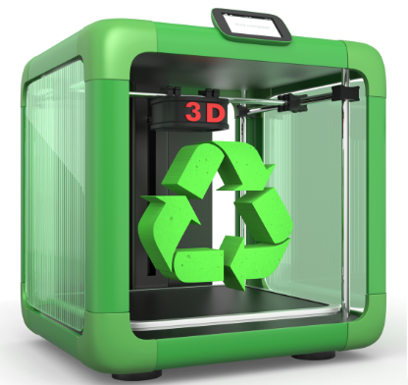
Additive Manufacturing (3D-print) and supply resilience
Pantea Khanshaghaghi
Equinor
July 2021

Slide 2
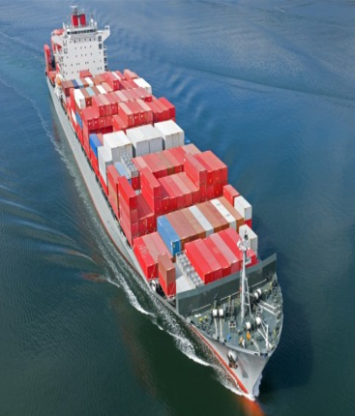
The concerns
Security of supply
31%
8,6%
100bn tonnes

Slide 3
Equinor’s climate roadmap towards 2050
Profitable growth in renewables
Climate is embedded in our decision-making
We use our voice to drive change
Industry leading in carbon efficiency
Net-zero company
Accelerate decarbonisation

Slide 4
AM is where the digital and physical worlds meet !
Digital Supply Networks
JUST IN TIME

Slide 5
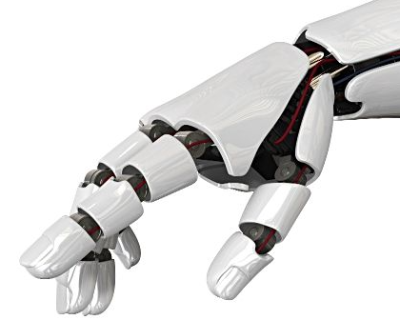
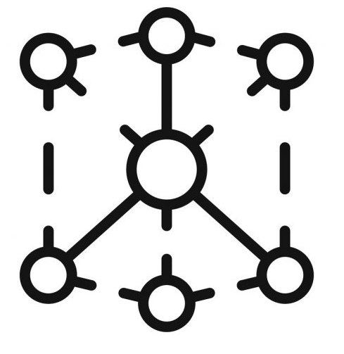
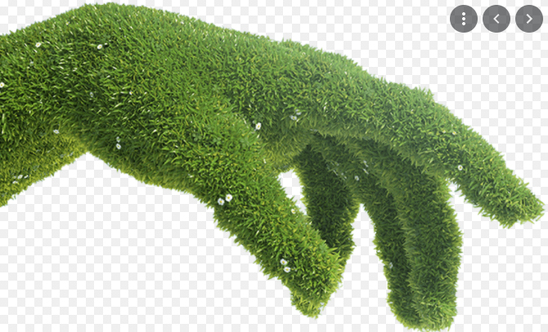
AM & Circular Economy
RAW MATERIALS

Slide 6
Toward co-creation model
Life cycle perspective
Shared risk & reward
Policy & Regulatory framework
Government support
Suppliers
Policy makers
Eco system
Cost & Carbon efficient
On demand production
Sustainable financing
Market efficiency
End users
Investors

