Slide 1
EU Industrial Strategy & Additive Manufacturing: Increasing the resilience of the industrial ecosystems
Ulla Engelmann
Acting Director - Networks and Governance
DG GROW - European Commission
8 July 2021

Slide 2
Importance of the manufacturing industry in Europe
The manufacturing industry is a strong asset for the European economy and an important driver of employment and prosperity.
It also plays a key role in research and innovation, being responsible for 64% of private sector research development expenditure and 49% of innovation expenditure in Europe.
The manufacturing sector accounts for:
2 million enterprises (around 1 in 10 of all enterprises in the EU-27’s non-financial businesses)
€2,078 billion in gross value added
32.1 million jobs in 2019 in manufacturing in the EU 27 (including 14.5 million jobs in advanced manufacturing)

Slide 3
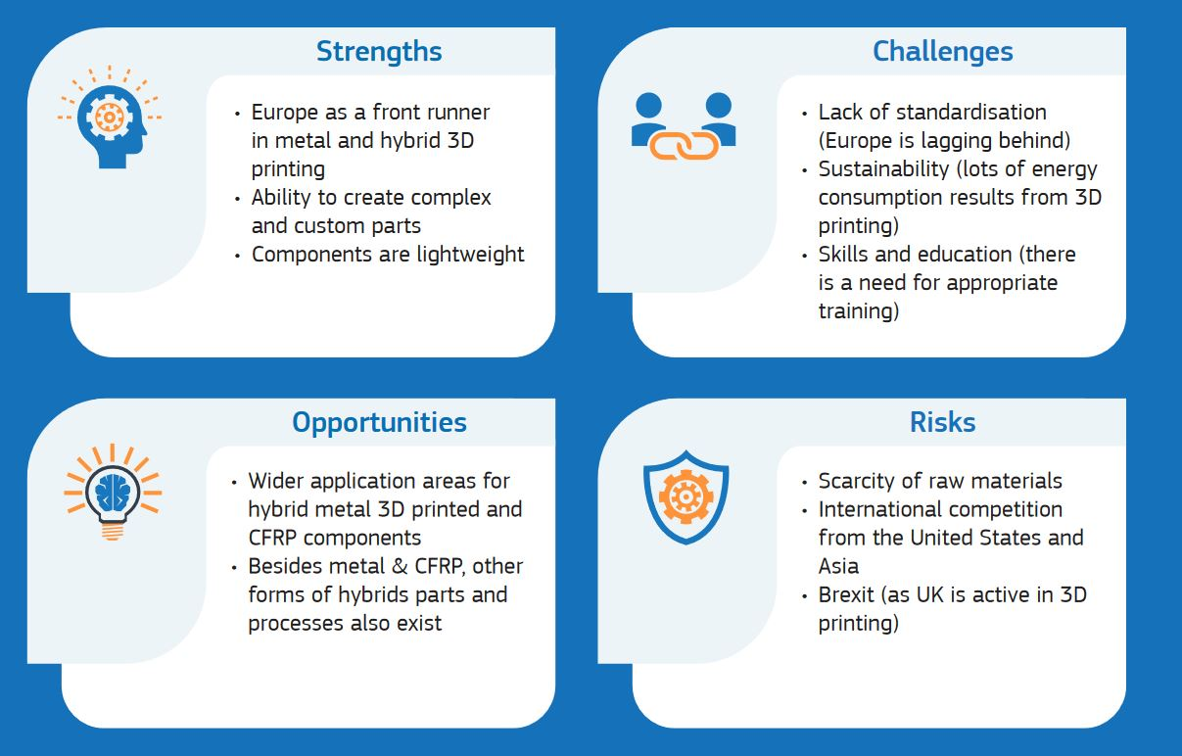
EU competitive positioning in additive manufacturing
The EU is a front runner in metal and hybrid 3D printing but faces challenges in terms of standardisation and scarcity of raw materials

Slide 4
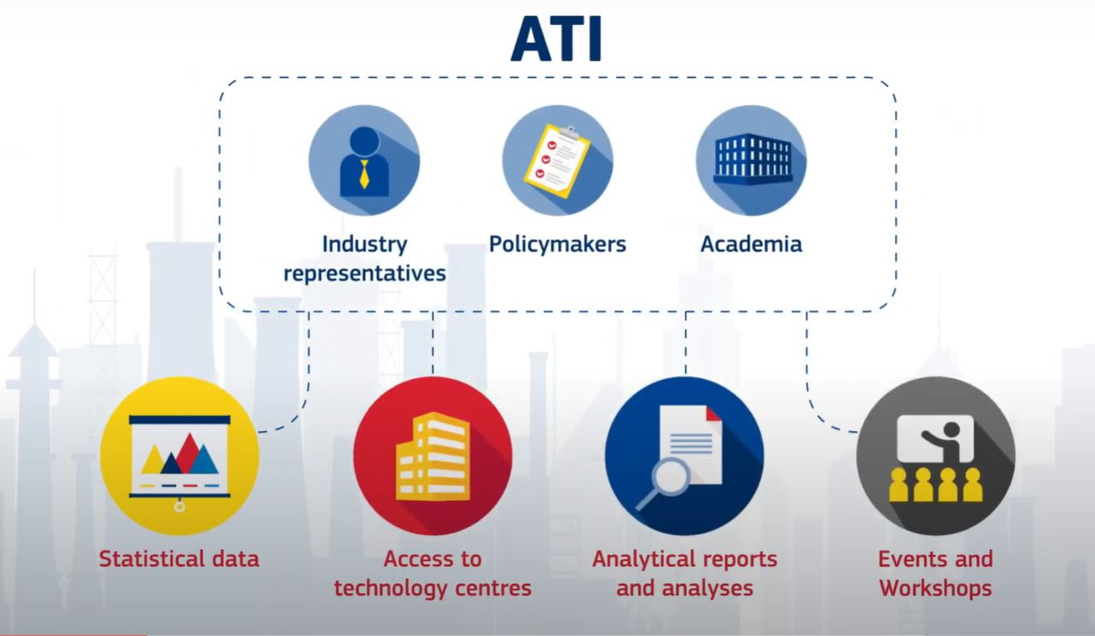
Advanced Technologies for Industry Monitor
The Advanced Technologies for Industry analyses and systematically monitors the state of uptake of advanced technologies by EU industry.
The main users of this project are policymakers, industry representatives and academia.
https://ati.ec.europa.eu/

Slide 5
About the Industrial Forum
„The Industrial Forum is a new, inclusive and open mechanism for co-designing solutions with stakeholders, supporting the Commission in its systematic analysis of the ecosystems and in assessing the risks and needs of industry as it embarks on the twin, green and digital, transition and the strengthening of its resilience.”
Up to 55 members
2 observers invited
Composition
Member States authorities
Industrial associations, NGOs, trade unions, research and technology organisations, representatives of the financial/investment sector, associations of regions or of regional development agencies

Slide 6
Thank you!

