Slide 1
Skilling and upskilling to enable the green transition
Milan, Italy
6th June 2023

Slide 2
Overview
Green trends and jobs
Needs and barriers
Skilling Solutions

Slide 3
Technology adoption will remain a key driver of business transformation in the next five years (..) The impact of investments to drive the green transition was judged to be the sixth-most impactful macrotrend.
WEF Future of Jobs Report 2023

Slide 4
Megatrends driving business transformation

Slide 5
Businesses predict the strongest net job-creation effect to be driven by
investments that facilitate the green transition of businesses,
the broader application of ESG standards and
supply chains becoming more localized.with job growth offset by partial job displacement in each case
WEF Future of Jobs Report 2023
Notes:
businesses predict the strongest net job-creation effect to be driven by investments that facilitate the green transition of businesses, the broader application of ESG standards and supply chains becoming more localized, albeit with job growth offset by partial job displacement in each case

Slide 6
Manufacturing Community Consultation open survey consultation workshop with our partners
Notes:
Why?
To engage our core partners and the manufacturing community in the definition of the call thematics.
Improve call thematics and understand the actual needs of the industry
Effectively manage the time and not reinvent the wheel, by starting from the feedback already collected
What?
Open consultation process divided in 2 steps:
Survey open to the European manufacturing community
Consultation Workshop with EITM Core Partners
Consultation Process – Survey
Collaborate to define the future direction of innovation and skills development efforts in the manufacturing sector.
The workshop promoted cross-disciplinary exchange of ideas, resulting in more innovative and effective approaches to advancing the manufacturing sector.
73 participants from 42 EIT Manufacturing partners
2 workshop sessions about skills development focusing in 4 top priorities
3 key work areas: mid-term outcomes, barriers and skills development methods
Consultation Process – Workshop
Collaborate to define the future direction of innovation and skills development efforts in the manufacturing sector.
The workshop promoted cross-disciplinary exchange of ideas, resulting in more innovative and effective approaches to advancing the manufacturing sector.
73 participants from 42 EIT Manufacturing partners
2 workshop sessions about skills development focusing in 4 top priorities
3 key work areas: mid-term outcomes, barriers and skills development methods

Slide 7
Top Priority 1 – Sustainability: Skills for identifying and applying enabling technologies for sustainable manufacturing
Mid term results
Development of life cycle assessment and lean production skills for CO2 neutral manufacturing for any hierarchical level or functional area of the company/organisation.
Barriers
the high cost of implementing such technologies
the complexity and technically advanced nature of these technologies that explain a lack of awareness and knowledge of the operators, designers, and managers.
lack of knowledge transfer from academia to industry is a deterrent factor.
Development of a personnel holistic sustainability view of product design principles, production line, and the use of sustainable materials.
Standards and best practices for the manufacturing industry, including capability building for compliance with EC/national/regional regulations and directives.
Development of toolkits and metrics for measuring sustainability in factories.
Notes:
Product/material – production – Lifecycle perspective - analize prioritize – create a roadmpap
Regulations – standards – best practice
Toolkit and metrics
Top Priority 2 – Digitalization: Identification and development of skills to define and execute a digital transformation roadmap at the production level
Top Priority 3 – Transversal Skills: Develop skills on Critical Thinking, Problem Solving, Creativity, and Initiative for Digital manufacturing ecosystem
Top Priority 4 – Future trends: Needs in upskilling and reskilling in Re-manufacturing and critical resources

Slide 8
EIT Manufacturing skilling and up-skilling

Slide 9
GIRLS GO CIRCULAR in collaboration with the other Knowledge Innovation Communities
The Girls Go Circular project is doing its share in contributing to reducing the digital gender gap by empowering girls aged 14-19 in Europe to develop their digital and entrepreneurial competencies while acquiring knowledge on the circular economy.
26000+ girls empowered
1000+ Schools supported
13 modules developed
16 languages available

Slide 10
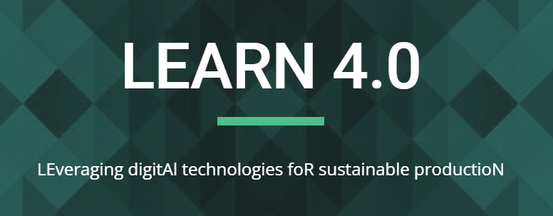
LEARN 4.0: the sustainable path toward industry 4.0
Digital technologies for sustainable production. By bringing together digitalization and sustainability, LEARN 4.0 offers learning paths for up-skilling manufacturing operators that will drive European manufacturing towards sustainable, net zero emission production environments.
4 Sustainability Learning Journeys
150 digital nuggets bundled into 23 learning paths with a high degree of personalization
5 European partners working together
Innovation and change management
Introduction to sustainable production
Introduction to circular design
I4.0 for sustainability & circular economy

Slide 11
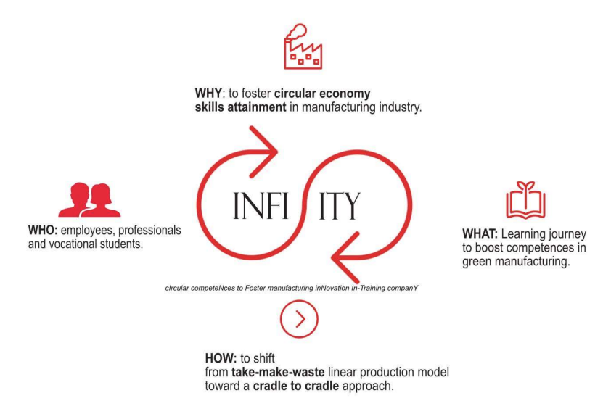
Infinity: Circular competences to foster manufacturing innovation
OPTION 1
450 participants targeted
13 learning modules ready by 2024
50 learning nuggets
5 European partners working together

Slide 12
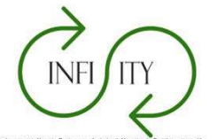
Infinity: Circular competences to foster manufacturing innovation
OPTION 2
INFINITY aims at fostering circular economy skills attainment in manufacturing industries for employees, as well as vocational learners, focusing on technical areas of low environmental footprint systems for green manufacturing.
Shift from “take-make-waste” thinking toward a “cradle to cradle” approach.
450 participants targeted
13 learning modules ready by 2024
50 learning nuggets
5 European partners working together

Slide 13
LRM: Lean remanufacturing
LRM supports the development of lean, circular (re)manufacturing into companies across Europe.
Its mission is to help boost and accelerate the transition to improved manufacturing sustainability through bringing together lean manufacturing methods with the circular nature of remanufacturing.
+160 professionals trained in 2022
+20 Companies involved
+16 workshops delivered
4 European partners working together

Slide 14
Green (sustainability) & digital skills
+ innovation and entrepreneurial competencies and mindset

Slide 15
Thank you!
@EITManufactur
@EITManufacturing
eitmanufacturing
eitmanufacturing.eu

